Slide 1
Anemia
By
Dr. Hussein AlNaji

Slide 2
Anemia
True or absolute anemia is defined as a decrease in erythrocyte mass within the body. HCT, hemoglobin, and RBC count values are usually below their reference intervals.
Low erythrocyte parameters may also be present in blood when the total-body erythrocyte mass is normal (relative anemia).

Slide 3
This can result from
1- overhydration resulting in erythrocyte dilution
2- splenic sequestration of eryth­rocytes as occurs with
splenic relaxation during anesthesia,
heparin-induced erythrocyte agglutination in horses.
various causes of splenomegaly.
Anemia may occur following blood loss, increased eryth­rocyte destruction, or decreased erythrocyte production.

Slide 4
Factors that can be useful in categorizing anemia into these broad causes (and often into more specific causes) include
reticulocyte counts.
erythrocyte indices.
erythrocyte morphol­ogy on stained blood films.
the appearance of the plasma.
plasma protein concentration.
serum iron measurements.
bone marrow evaluation.

Slide 5
There are two types of anemia: regenerative and non-regenerative.
In non-regenerative anemia, the cause is usually a decrease in erythropoietin (a hormone controlled by the kidneys that influences red blood cell production as a response to low oxygen in tissues) or bone marrow abnormalities. The bone marrow does not effectively respond to the decrease levels of red blood cells.
Regenerative anemia, alternatively, the bone marrow responds to the anemia by increasing production of red blood cells and releasing reticulocytes (immature red blood cells that don’t have a nucleus). Regenerative anemia can be caused by a hemorrhage or hemolysis (the rupture or destruction of blood cells).

Slide 6
Causes of Regenerative Anemia
poisoning, infection, trauma, or other conditions that may cause a loss of blood or hemolysis (shortened life span of erythrocytes).
Oxidation Blood
loss Immune-mediated hemolysis:
Decreased marrow production
Babesia spp infection
Hemolysis caused by phosphorous deficiency, seen in dogs with diabetes, hepatic lipidosis, and refeeding syndrome
Genetic

Slide 7
Symptoms of Regenerative Anemia in Dogs.
Symptoms vary depending on the degree, duration, and cause of the anemia, but may include:
Tachycardia (fast heart rate)
Pale mucous membranes
Hypotension (low blood pressure)
Lethargy, Weakness and Anorexia
Splenomegaly (enlarged spleen) and Abdominal distension
Heart murmur 7. Jaundice
8. Shock 9. Death

Slide 8
Classification of Anemia Using Erythrocyte Indices
An anemia can also be classified using the MCV and MCHC values to assist in determining its cause. The terms used to indicate size are macrocytic (increased MCV), normocytic (normal MCV), and microcytic (decreased MCV). The terms used to describe MCHC values are normochromic (normal MCHC) and hypochromic (decreased MCHC).

Slide 9
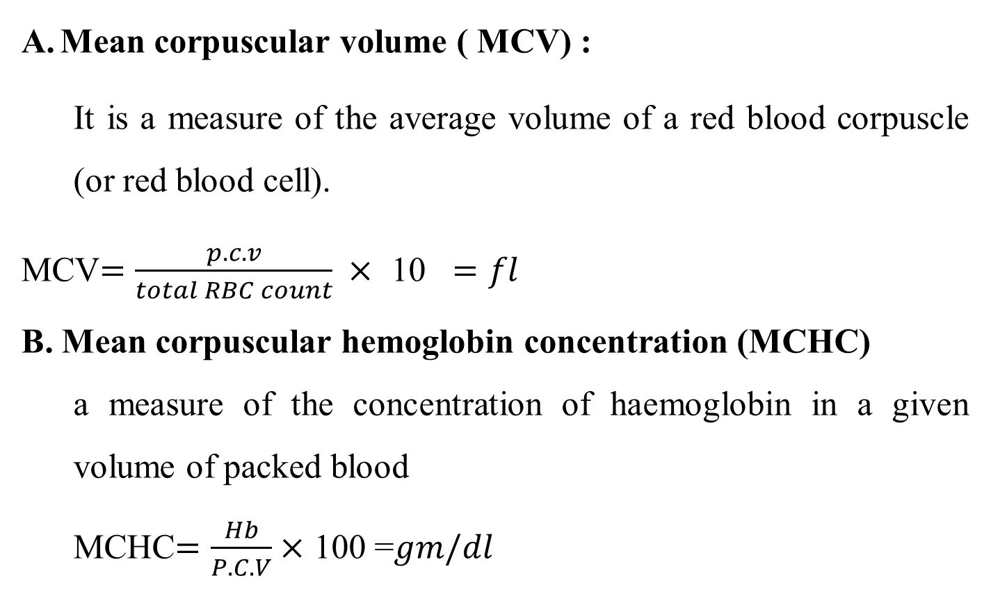
Mean corpuscular volume ( MCV) :
It is a measure of the average volume of a red blood corpuscle (or red blood cell).
MCV$=\frac{p.c.v}{total RBC count} ×$ 10 $=fl$
B. Mean corpuscular hemoglobin concentration (MCHC)
a measure of the concentration of haemoglobin in a given volume of packed blood
MCHC$=\frac{Hb}{P.C.V}×$ 100 =$gm/dl$

Slide 10
The anemia depended on MCV and MCHC include four types
A- Normocytic Normochromic
1. Hemolytic anemia. 2. Hemorrhage.
3. Early iron-deficiency anemia before microcytes predominate
4. Chronic inflammation and neoplasia (sometimes slightly microcytic)
5. Chronic renal disease 6. Endocrine deficiencies
8. Selective erythroid aplasia
8. Aplastic and hypoplastic bone marrows
9. Lead toxicity (may not be anemic

Slide 11
B- Macrocytic Hypochromic
1. Regenerative anemias with marked reticulocytosis
2. Spurious with prolonged storage of blood sample
C- Macrocytic Normochromic
1. Regenerative anemias (decreased MCHC is not always present)
2. FeLV infections with no reticulocytosis (common)
3. Erythroleukemia (AML-M6)
5. Hyperthyroid cats (slight macrocytosis without anemia)
6. Folate deficiency (rare)
7. Congenital dyserythropoiesis of Hereford calves

Slide 12
- Microcytic Normochromic/Hypochromicª
1. Chronic iron deficiency (months in adults, weeks in nursing animals)
2. Anemia of inflammatory disease (usually normocytic)
3. Hepatic lipidosis in cats (usually normocytic)
4. Prolonged recombinant erythropoietin treatment (mild)
5. Copper deficiency (rare)
6. Drugs or compounds that inhibit heme synthesis
7. Pyridoxine deficiency (experimental)
8. Spurious when platelets are included in erythrocyte histograms

